Slide 1
Examining the intersection between Sexual Orientation & Gender Identity and Mental Health.
Stuart McKenna
Equality and Diversity Manager, Manchester Metropolitan University.

Slide 2
Introduction.
There is significant evidence that LGBT individuals are at a higher risk of experiencing poor mental health during their lifetimes.
This presentation looks at a model of minority stress (Meyer, 2003) as a mechanism by which this occurs, and some of the specific stressors experienced by LGBT people.
We also examine some of the interventions that everyone can engage in to reduce the potential stressors for LGBT people.
Warning: Some of the images contained in this presentation contain incidences of overt discrimination, hate crime and language which some may find offensive.

Slide 3
LGBT in Britain: Health Report (Stonewall, 2018)
Half of all LGBT people (52%) said they’ve experienced depression in the last year.
One in eight LGBT people aged 18-24 (13%) said they’ve attempted to take their own life in the last year.
Almost half of trans people (46%) have thought about taking their own life in the last year, 31 per cent of LGB people who aren’t trans said the same.
Forty one per cent of non-binary people said they’ve harmed themselves in the last year compared to 20 per cent of LGBT women and 12 per cent of GBT men

Slide 4
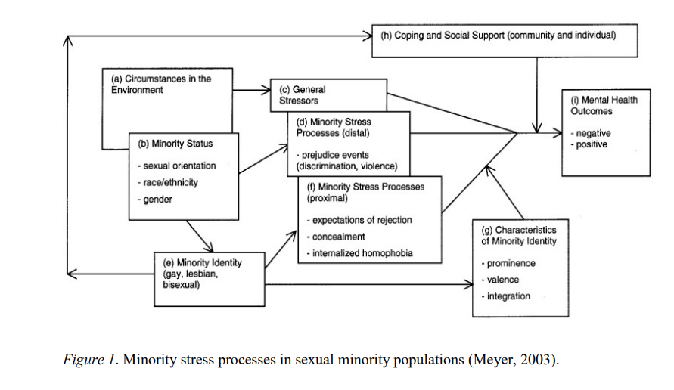
Minority Stress Model (Meyer, 2003).

Slide 5
Distal (External) Minority Stressors.
Workplace discrimination.
Societal Discrimination.
Bullying and Discrimination within LGB spaces.
Hate Crime.

Slide 6
Workplace Discrimination.
Almost one in five LGBT staff (18 per cent) have been the target of negative comments or conduct from work colleagues in the last year because they're LGBT.
One in eight trans people (12 per cent) have been physically attacked by customers or colleagues in the last year because of being trans.
One in ten Black, Asian and Minority Ethnic LGBT staff (10 per cent) have similarly been physically attacked because of their sexual orientation and/or gender identity, compared to three per cent of white LGBT staff.

Slide 7
Workplace Discrimination.
Almost one in five LGBT people (18 per cent) who were looking for work said they were discriminated against because of their sexual orientation and/or gender identity while trying to get a job in the last year.
One in eight Black, Asian and Minority Ethnic LGBT employees (12 per cent) have lost a job in the last year because of being LGBT, compared to four per cent of white LGBT staff.

Slide 8
Workplace Discrimination.
One in eight lesbian, gay and bi people (12 per cent) wouldn’t feel confident reporting any homophobic or biphobic bullying to their employer. One in five trans people (21 per cent) wouldn’t report transphobic bullying in the workplace.
Almost a third of non-binary people (31 per cent) and one in five trans people (18 per cent) don’t feel able to wear work attire representing their gender expression.

Slide 9
Societal Discrimination.
One in 10 LGBT people (10 per cent) who were looking for a house or flat to rent or buy in the last year were discriminated against because of their sexual orientation and/or gender identity.
One in six LGBT people (17 per cent) who visited a café, restaurant, bar or nightclub in the last 12 months have been discriminated against based on their sexual orientation and/or gender identity.
One in four Black, Asian and Minority Ethnic LGBT people (24 per cent) accessing social services in the last year have been discriminated against because of their sexual orientation and/or gender identity.

Slide 10
Societal Discrimination.
Almost three in 10 LGBT people (28 per cent) who visited a faith service or place of worship in the past 12 months experienced discrimination.
One in ten LGBT people (10 per cent) who attended a live sporting event in the last year experienced discrimination because of their sexual orientation and/or gender identity.

Slide 11
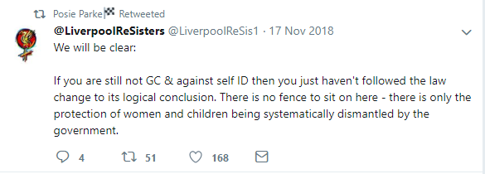
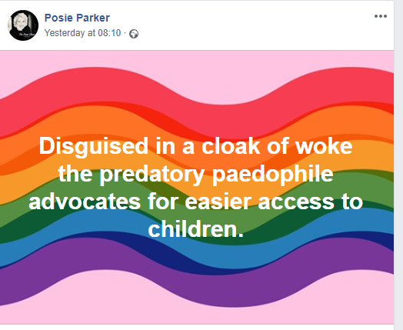
Societal Discrimination (The rise in Transphobic discrimination).

Slide 12
Discrimination within LGBT spaces.

Slide 13
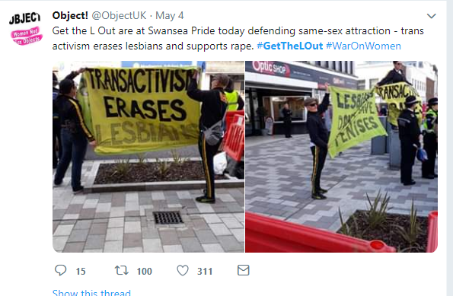
Bullying within LGBT spaces.

Slide 14
Bullying within LGB spaces.

Slide 15
Hate Crime.
Four in five LGBT people (81 per cent) who experienced a hate crime or incident didn't report it to the police.
Three in 10 LGBT people (29 per cent) avoid certain streets because they do not feel safe there as an LGBT person.
More than a third of LGBT people (36 per cent) say they don’t feel comfortable walking down the street while holding their partner's hand. This increases to three in five gay men (58 per cent).
One in 10 LGBT people (10 per cent) have experienced homophobic, biphobic or transphobic abuse online directed towards them personally in the last month. This number increases to one in four for trans people (26 per cent) directly experiencing transphobic abuse online in the last month.

Slide 16
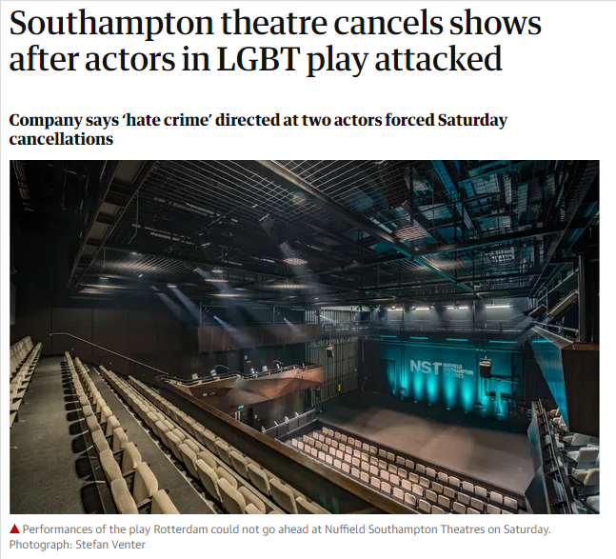
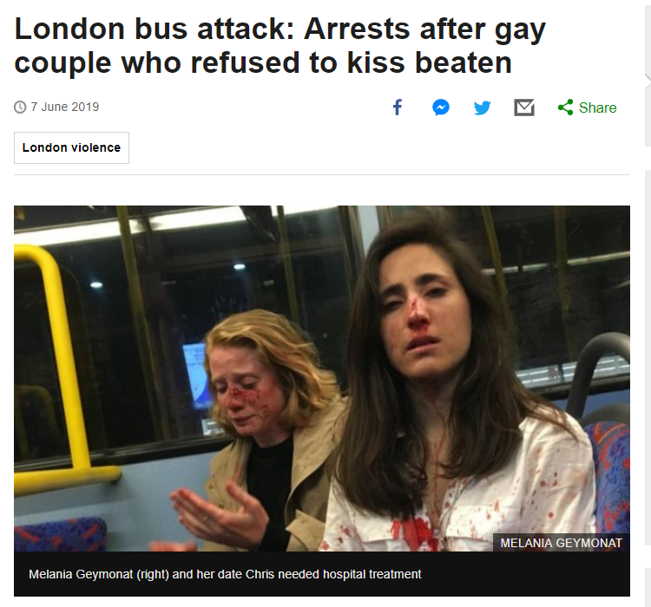
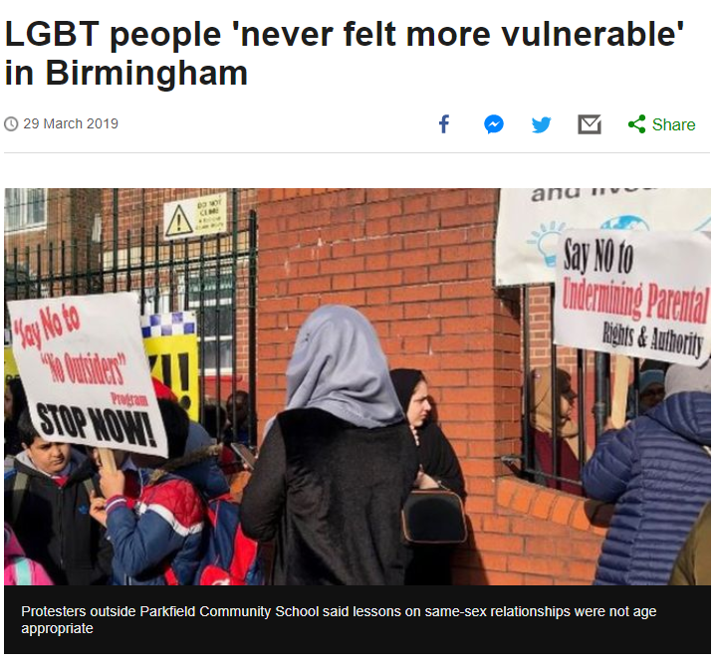
Hate Crime.

Slide 17
Minority Stress Model (Meyer, 2003).

Slide 18
Proximal (Internal) Minority Stressors.
Internalised homophobia/biphobia/transphobia.
Concealment.

Slide 19
Internalised homophobia/biphobia/transphobia.
Simply put, internalised HBT* happens when LGBT individuals are subjected to society’s negative perceptions, intolerance and stigmas towards LGBT people, and as a result, turn those ideas inward believing they are true.
Throughout the literature, internalised homophobia has been linked with various mental health difficulties and other psychosocial issues.
Meyer and Dean (1998) proposed that internalised homophobia is associated with a two-to-three fold increase in risk for psychological distress.
*Homophobia/Biphobia/Transphobia

Slide 20
Concealment.
Unresolved sexual identity issues heighten anxiety, loneliness, and isolation, and create a fear that life is not going to turn out as planned.
LGB individuals often conceal their sexual orientation in order to avoid stress in the environment. Paradoxically, concealment of sexual orientation is an additional stressor and is negatively related to mental health (Jelić, 2016).
More than a third of LGBT staff (35 per cent) have hidden or disguised that they are LGBT at work in the last year because they were afraid of discrimination (Stonewall, 2018).
Almost two in five bi people (38 per cent) aren’t out to anyone at work about their sexual orientation (Stonewall, 2018).

Slide 21
Interventions

Slide 22
Interventions.
All of us need to call out all forms of discrimination, not least in the workplace.
In particular, in LGBT spaces, we need to call out racism, ageism, ableism and transphobia.
We need open and honest conversations about mental ill health in LGBT spaces.
Consider the mechanisms and places where hate crimes can be reported.
Be an active Ally.

Slide 23
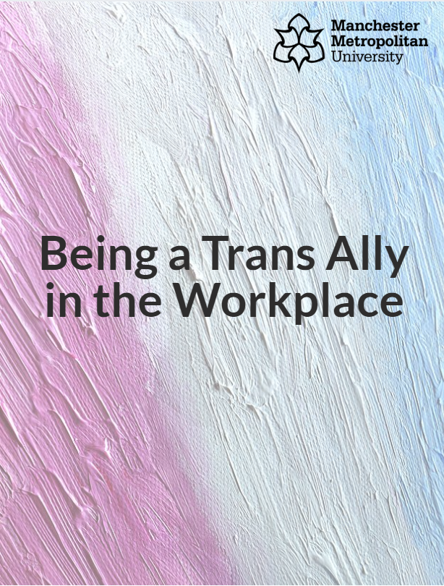
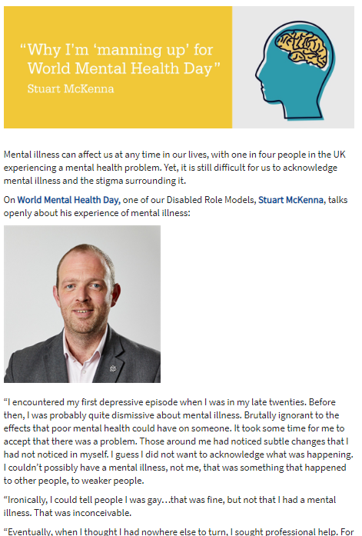
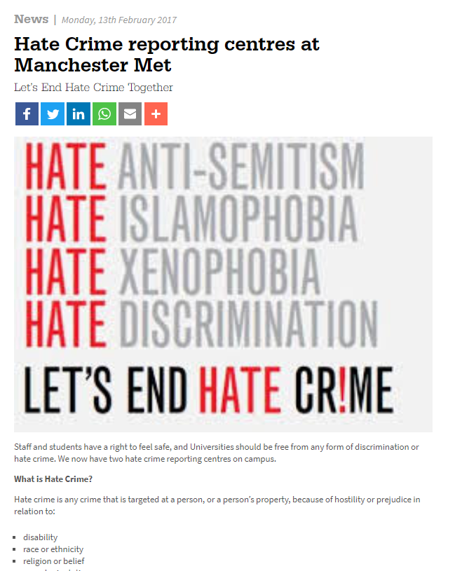
Interventions at Manchester Met.

Slide 24
Sometimes it’s the simple things
#postyoursupport campaign.
Encourages staff to consider why LGBT equality was important and post to social media.
Opportunity to recruit LGBT Allies.
Cost effective.
24,000 Twitter impressions as a result of this campaign.

Slide 25
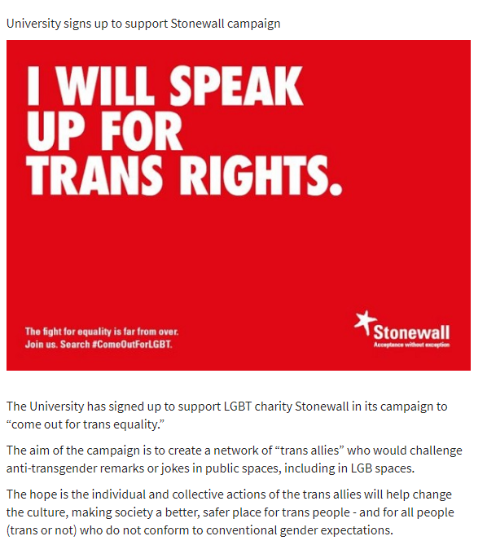
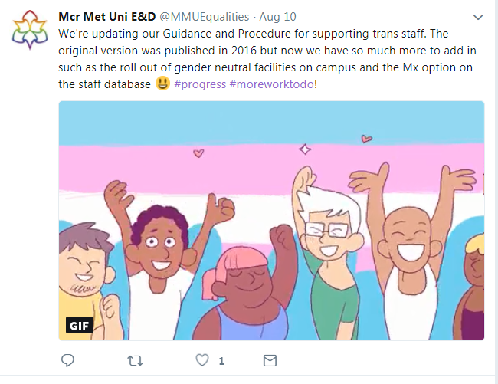
Some good practice tips

Slide 26
