Slide 1
Is it mental illness: a workshop exploring the intersectionality between LGBT+ and faith identities
Rev Dr Adam J Scott CPsychol

Slide 2
Welcome
Experiential workshop – my experience and your experience
Care for yourself and others
Humanistic-existential approach woven through workshop.
I don’t speak for all LGBT+ people, or religious people, but I never could!
We will hear some material which some may find offensive. I would ask you to listen and be aware by listening we are not agreeing with them.

Slide 3
Mental Illness = LGBT+ & faith
Watch: https://www.youtube.com/watch?v=WnBBqYFGKB8
How did you experience this interview?
What stories have you heard about LGBT+ being viewed as a mental illness?
What stories have you heard about religious perspectives of LGBT+ people?

Slide 4
Mental Illness: LGBT+ & faith
‘Faith cannot move mountains (though generations of children are solemnly told the contrary and believe it). But it is capable of driving people to such dangerous folly that faith seems to me to qualify as a kind of mental illness. It leads people to believe in whatever it is so strongly that in extreme cases they are prepared to kill and to die for it without the need for further justification.’(Dawkins, 1989, The Selfish Gene, p. 198)
How do you respond to this quote?
In your experience, is their truth within it?

Slide 5
LGBT+ & faith = mental health
Things LGBT+ people of faith have taught me:
Learn to love listening
Learn that God doesn’t make outsiders
Learn to trust your own experience
Learn to channel your pain

Slide 6
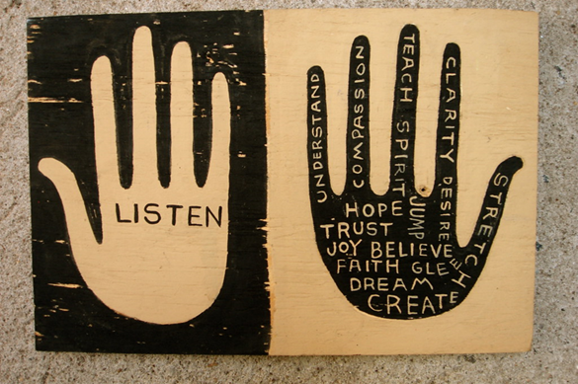
Love listening
Image: ‘listen & hope’, by Denise Carbonell, www.metalthread.com, in public domain

Slide 7
Learn God doesn’t make outsiders
‘We all sit in God’s Classroom
Hafiz tell us that Love’s Journey unfolds through every process of life. Divine principles are constantly being demonstrated all around us. We cannot learn them through words or books or limited systems of human values. Hafiz says God is fully known only through love, which accepts everything. Love reveals the Universe as a cosmic playground where every thing and being participates in a single, magnificent Game.
“God has shouted ‘Yes! Yes! Yes!’ To every luminous movement in Existence.”’
(Ladinsky, 2006, p.21)

Slide 8
Trust your own experience
‘Take heed, dear Friends, to the promptings of love and truth in your hearts. Trust them as the leadings of God whose Light shows us our darkness and brings us to new life.’
(Religious Society of Friends (Quakers), 2013, 1:02)

Slide 9
Channel your pain
‘The fruity curse
Some of you asked me after I received hate mail … how I got rid of my own hate – because in a time of racism and recession there’s a lot of it around, and prayer doesn’t always shift it. Here’s the East European Jewish suggestion. Curse it away! But make your curses so fruity that your hate evaporates and you fall about with laughter. It’s such an effective spiritual therapy. You can use these examples as models:
‘May your house have a hundred rooms, each with a hundred beds and may you have bad nights on all of them.’
‘May all your teeth fall out except one, so that you may still get toothache.’’
(Blue, 1994, p. 81)

Slide 10
Brief bibliography 1/2
Alison, J. (2004). On being liked. Darton, Longman and Todd: London.
Blue, L. (1994). Tales of body and soul: ‘His wisdom and comfort for everybody’. Hodder & Stoughton: London.
Bohart, A. C. (2007) ‘The actualizing person’, in Cooper, M., O’Hara, M., Schmid, P. F., and Wyatt, G. (eds.), The handbook of person-centred psychotherapy and counselling, pp. 47 – 63. Hampshire: Palgrave Macmillan.
Carr, A. (2011) Positive psychology: the science of happiness and human strength. 2 nd edn. London: Routledge.
Du Plock, S. (2010) ‘Humanistic approaches’, in Woofle, R., Strawbridge, S., Douglas, B. and Dryden, W. (eds.) Handbook of counselling psychology. 3 rd edn. London: Sage, pp. 130-150.
Gillon, E. (2007). Person-Centred Counselling Psychology: an introduction. Sage: London.
Greening, T. (2006) ‘Five basic postulates of humanistic psychology’, Journal of Humanistic Psychology, 46(3), p. 239.
Ladinsky, D. (2006). I heard GOD laughing: poems of hope and joy, renderings of Hafiz. Penguin: London.
Linn, M., Fabricant Linn, S. and Linn, D. (2000). Understanding difficult scriptures in a healing way. Paulist Press: New Jersey.
Maslow, A. (1956) ‘Toward a humanistic psychology’, ETC: a review of general semantics, 14(1), pp. 10 – 22. • Maslow, A. (1968) Toward a psychology of being. 2 nd edn. New York: D. Van Nostrand.

Slide 11
Brief bibliography 2/2
May, R. (1958) ‘Contributions of existential psychotherapy, in May, R., Angel, E. and Ellenberger, H. (eds.), Existence: a new dimension in psychiatry and psychology. New York: Basic books, pp. 37 – 91.
Nouwen, H. J. M. (2010) The Wounded Healer: ministry in contemporary society. London: DLT.
O’Donohue, J. (1997) Anam cara: spiritual wisdom from the celtic world. London: Bantam.
Religious Society of Friends (Quakers), (2013). Quaker faith and practice: the book of Christian discipline of the Yearly Meeting of the Religious Society of Friends (Quakers) in Britain. (5th ed.). Yearly Meeting of the Religious Society of Friends (Quakers) in Britain: London.
Rogers, C. (1951) Client-centred therapy. London: Constable. •
Rogers, C. (1961) On becoming a person: a therapist’s view of psychotherapy. London: Constable.
Rogers, C. (1980) A way of being. New York: Houghton.
Rohr, R. (2009). The naked now: learning to see how the mystics see. Crossroad: New York.
Rowan, J. (1998) The reality game: a guide to humanistic counselling and psychotherapy. 2 nd edn. London: Routledge
Thorne, B. (1998) Person-centred counselling and Christian spirituality: the secular and the holy. London: Whurr.
Yalom, I. (1980). Existential Psychotherapy. Basic Books: New York.

