Slide 1
The Disability-LGBTQ+ intersection: challenging stigma and misconceptions
Hosted by: Embed Consortium
Ed Moss, Sarah Simcoe, Martin York

Slide 2
Welcome
Who we are?
What we will be doing in this workshop?

Slide 3
Introductions and agreements
Chatham House rules
Open, inclusive and supportive
Active and respectful listening
Action orientated and accountability
No phones

Slide 4
Icebreaker
Notes:
ED
Ice breaker: which teapot – explanation and guidance that we only want a short contribution. We may not have enough time to cover everyone but we’ll get through as many as possible
5 mins in smaller table groups
Selection of photos of teapots on your tables but you can also create an imaginary one
MARTIN
5 mins plenary sharing
Rotate round the tables one person per table

Slide 5
Notes:
ED
Ice breaker: which teapot – explanation and guidance that we only want a short contribution. We may not have enough time to cover everyone but we’ll get through as many as possible
5 mins in smaller table groups
Selection of photos of teapots on your tables but you can also create an imaginary one
MARTIN
5 mins plenary sharing
Rotate round the tables one person per table

Slide 6
How we make decisions
Right
Wrong
Good
Bad
Love
Hate
Government
Opposition

Slide 7
6 thinking hats
Black Hat
Difficulties, potential problems, why something may not work
White Hat
Data, facts, information known or needed
Red Hat
Feeling, hunches, instinct and intuition.
Yellow Hat
Value and benefits, why something may work
Blue Hat
Manage process, next steps, action plans
Green Hat
Creativity, solutions, alternatives, new ideas
Notes:
ED
Overview of what these are and how they work
Each group will be 6 people so take a hat per person in the discussion
Each table has large sheets to record their findings on
6 thinking hats is a useful technique that helps to inform thinking, but the most important aspect is the discussion

Slide 8
Themes for discussion
Tables | Discussion theme
1 and 4 | Disability / GISO balance when considering personal identities
2 and 5 | Social acceptability including hierarchies of acceptability
3 and 6 | Friendship groups and peer pressure
Notes:
MARTIN
Did anyone not read through the structure of the workshop? Recap if so
Each table has one of the themes on the slide and we’ve given you starter questions to explore. You can also explore your own questions if you prefer. The questions you have been given are:
Disability/GISO balance
What experiences have you had or observed about being a minority within a minority?
What barriers have you observed during disclosure, coming out or sharing?
Is there an equal level of tolerance in different minority groups for the unknown?
Social acceptability and hierarchies
Are some conditions more socially acceptable than others?
Does society suffer from paralysis in not knowing how to interact appropriately?
Are there underlying themes of good or bad behaviour triggered by unconnected societal events?
Friendship groups and peer pressure
Why does mental health continue to be a more challenging topic than physical health?
Are there concerns about going back into an undisclosed state when thinking about career options?
How supported did you feel within your friendship group (e.g. pressure to conform)?

Slide 9
Considerations
What barriers did you notice?
What questions does this pose for society?
What actions do we need to take as a society?
Personal experience or observation
Notes:
MARTIN
So for each of your questions in your groups we’d like you to explore these question
Your comments can be based on personal experience or observation

Slide 10
Q&A
Notes:
SARAH
Invite further questions from the attendees about what we’ve explored
Invite Ed & Martin to contribute additional insights through different lenses (e.g. workplace, facilitated sessions)

Slide 11
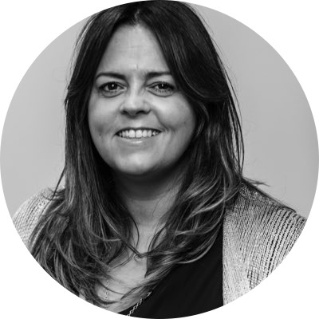
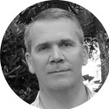
Thank you from the Embed consortium
For more information please contact info@embed.org.uk
or follow us on Twitter:
@EdMossBtG
@SarahSimcoe
@RarityMonk
Creator and Owner of EMBED
Making inclusive business your business
Majoyo Consulting
empower . grow . transform

