Slide 1


Owning your Identity
Jane Cordell and Hormoz Ahmadzadeh
NADSN & LGBT+ NoN
Intersectionality conference

Slide 2

Who is Result CIC?
Community Interest Company (social enterprise)
‘Confidently different, we empower marginalised groups to become positive role models’
www.resultcic.com
Notes:
J

Slide 3
Today
Who defines you?
What makes up your identity?
  What are the different elements of your identity?
  The strengths you have developed as a result.
  What barriers are there (perceived or real)?
  Using your strengths to overcome the barriers.
What label(s) define you?
Notes:
Jane

Slide 4
Who defines you?
Notes:
Jane

Slide 5
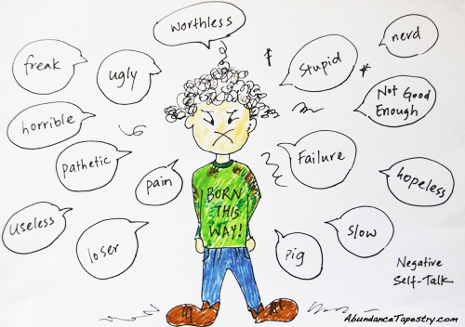
Labels
How do you think others may define you?

Slide 6
What makes up your identity?
Notes:
J

Slide 7
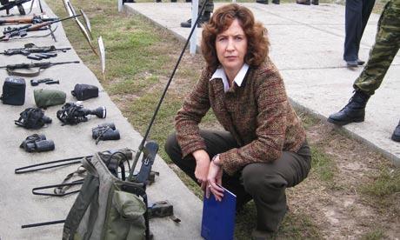
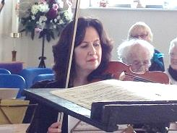
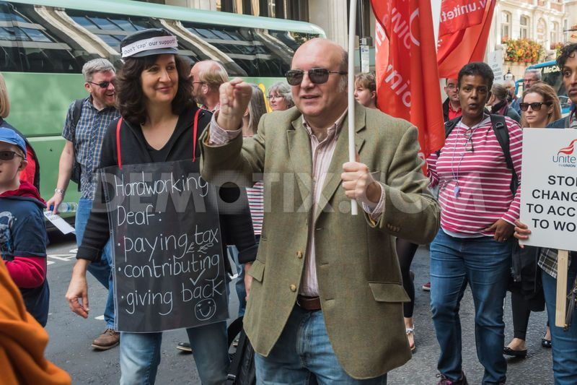
Which one is me?

Slide 8
Key points
I discovered..
How important my values were
I could define the terms of success
I became….
More resilient
More relaxed and less concerned with others’ impressions
I am…..
Still me – and more: musician, linguist, speaker, coach, entrepreneur – and happier
Notes:
J

Slide 9



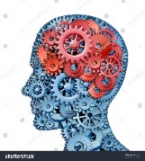
Degree/Refugee/British
on to a successful career as engineer and business development.
Gay – came out but not fully – only to select friends/family. Big internal struggle and within family.
Major mental breakdown and hospitalized over a 2 year period. Lowest point in my life.
Re-evaluation of aims, important aspects in life, wishes and limiting beliefs. Coach and trainer.
Authentic self and peace at last.
Notes:
Here age 15 – boarding school – challenges with identity – on reflection they were ‘character building’
Refugee – easier than now but for my core family to stay here, parents then me – period of anxiety
Career – multinationals like 3M and Corp Dev Mgr at MBS
Gay – internal struggle, then with family + society
Breakdown – depression - spiral, darkest of lows, sectioned, not talking, not eating, ect, cbt
Then high – gregarious, energised, dillusional, walked for 3 days + found myself in a high place looking at life, sectioned, medication, yoga, relaxation
Biploar
Building myself over several years of awareness, reflection, people focused and changing career to be coach/training facilitator

Slide 10
Key points
I discovered..
I was a closed person
Fearful of sharing too much of myself
Saw asking for help as a weakness
I became….
Aware of my real values
More aware of strengths and what I want
Aware of limiting beliefs
I am…..
The authentic me
Notes:
H

Slide 11
You and your strengths
Notes:
J

Slide 12
Strengths developed from the different and combined elements of your identity
Self awareness
Managing people
Innovation and flexibility
Dealing with challenges
Resilience
Communication skills
Handling time

Slide 13
Overcoming barriers
Notes:
H

Slide 14
Barriers
What do you think: are your added barriers because of who you are?
Have you examined whether these may be perceived or real?
How can you evaluate this?

Slide 15
Overcoming barriers
Think about your strengths and how you have used them to overcome barriers …
… what one thing can you take away with you and use positively?

Slide 16
Labels!
Notes:
H

Slide 17
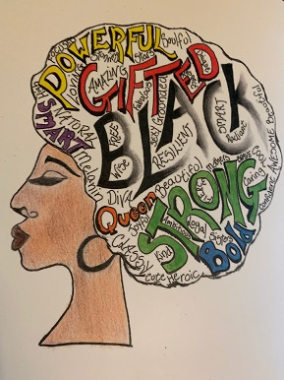

Slide 18

Feedback/questions?

Slide 19



Thank you. www.resultcic.com info@resultcic.com www.facebook.com/resultcic
@resultcic

