Slide 1
Taking an intersectional approach to Access & Participation Plans
Amy Norton & Alex Lewis
Equality & Diversity Team, Office for Students
NASDN & LGBT NoN Conference, Manchester Metropolitan University
20 June 2019
@AmyNorton8
@officestudents

Slide 2
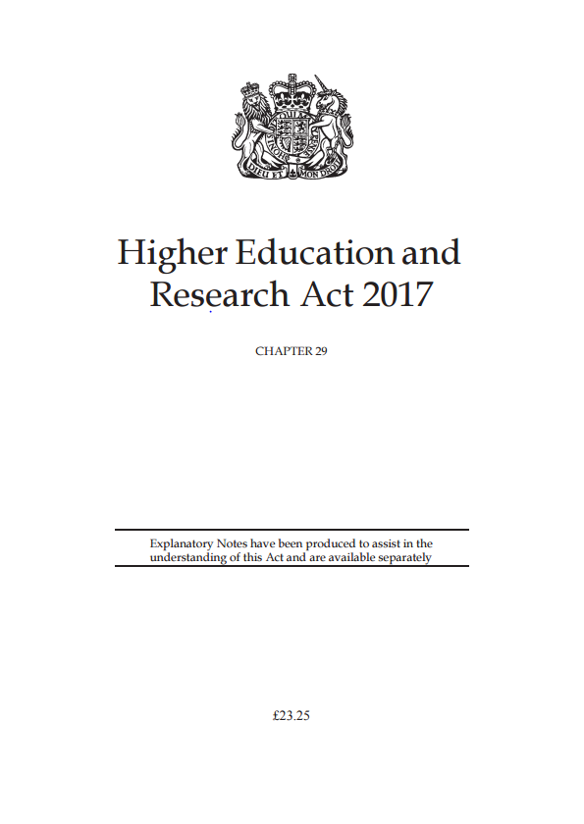
HERA 2017 (1)
(a) protect the institutional autonomy of English HE providers
(b) promote quality, and greater choice and opportunities for students, in the provision of HE
(c) encourage competition between English HE providers in connection with the provision of HE where that competition is in the interests of students and employers, while also having regard to the benefits for students and employers resulting from collaboration between such providers
(d) promote value for money in the provision of HE
(e) promote equality of opportunity in connection with access to and participation in HE
(f) use the OfS’s resources in an efficient, effective and economic way
(g) regulatory activities should be—
(i) transparent, accountable, proportionate and consistent, and
(ii) targeted only at cases in which action is needed.
Notes:
Why am I interested in this?
Worked in government for HEFCE, latterly as DoP
HE Act passed end April - only legislation squeezed through following spring 17 election
Section 81 – ‘HEFCE shall cease to exist’
Funding body with broad powers to support T, R and indeed any activity that a HEI wants to undertake, regulating through FM: centred on the Universitiy.
Replaced by:
Regulator acting in the interest of those paying for teaching i.e. students and taxpayers in competitive environment
Strategic investment agency, securing what the nation wants from the research base
Divergent views on whether this model is best, e.g. role of competition and choice, fracturing of T & R.
But consensus that FC model can’t work for new environment, so got through.
General duties – broad scope / balance. E of O central.

Slide 3
HERA 2017 (2)
The Director for Fair Access and Participation
The Director for Fair Access and Participation (“the Director”) is responsible
for (a) overseeing the performance of the OfS’s access and participation functions; (b) performing, in accordance with paragraph 11, any of those functions, or other functions, of the OfS which are delegated to the Director under that paragraph; and (c) reporting to the other members of the OfS on the performance of the OfS’s access and participation functions.
The Director may also report to the other members of the OfS on the measures taken by the OfS to comply with its duty under section 2(1)(e) (duty to have regard to the need to promote equality of opportunity etc) in performing a particular function of the OfS.
Notes:
Appointed in September to lead this aspect of OfS work - DFAP
Statutory role and Board member.
Guidance on and assessment of A & P plans – what will be done to promote E of O linked to higher fee
Good practice
Advise and report on E of O re: all of its work – broader challenge function.
Delegated powers – broad responsibility for me to judge what is sufficient within a plan and what is reasonable steps (though regulations help and backstop review)
What would be ‘fair’ access and participation?
What would be ‘equality of opportunity’ in relation to access and participation?
Where should we set the bar for universities to be doing enough to ‘promote’ this, in return for charging the higher fee and what is ‘good practice’?
How should we balance this duty alongside others such as protecting autonomy, promoting competition and choice, and being targeted and proportionate?

Slide 4
Our mission statement
We aim to ensure that every student, whatever their background,
has a fulfilling experience of
higher education that enriches
their lives and careers.

Slide 5
We aim to ensure that…
Every student, whatever their background, has a fulfilling experience of
higher education that enriches their lives and careers.
Participation
Experience
Outcomes
Objective 1
All students, from all backgrounds, with the ability and desire to undertake higher education, are supported to access, succeed in, and progress from higher education.
Objective 2
All students, from all backgrounds, receive a high quality academic experience, and their interests
are protected while they study
or in the event of provider,
campus or course closure.
Objective 3
All students, from all backgrounds, are able to progress into employment, further study,
and fulfilling lives, and their qualifications hold their value
over time.
Value for money
Objective 4
All students, from all backgrounds, receive value for money.

Slide 6


The Office for Students
‘Our regulatory framework enables the Director for Fair Access and Participation to develop a bold new approach to supporting social mobility, and equality and diversity, through higher education. …We will be radical and ambitious to make sure we deliver on the promise of higher education as an engine for social mobility, and a gateway to a better life for those who undertake it.’
Notes:
‘In all societies with a capitalist market economy, a conjugal family system and liberal-democratic policies, a limit may exist on the extent that mobility chances can be equalised. As this limit is approached, policies aimed at further equalisation will become increasingly contested, and social mobility will cease to be a matter on which political consensus prevails.’
Bukodi and Goldthorpe January 2019

Slide 7
What we are trying to achieve
Pressure
HERA 2017, general duty to promote equality of opportunity. s. 29 Special duty to regulate using A&P plans
Provider regulation through A&P Plans
Regulatory Notice 1
Impact reports
Conditions
Random sampling
Support
S.35 special duty to promote effective practice
Sector level
Regulatory Notice 6
Effective practice
Guidance and resources
Section on meaningful evaluation for providers with small HE student numbers
A-Z of effective practice
EIX – evidence and impact exchange
Evaluation tool
Dataset
Funding
Student premium funding
Eliminate
within a
generation
inequality
Notes:
So, what are we trying to achieve?
It can be difficult in today’s politics to find anything we all agree on, but there is now pretty much consensus in relation to need for regulation of and support for access and participation in HE. That’s why parliament placed in 2017 Act:
General duty on OfS to promote equality of opportunity in relation to access and participation and this has become a consideration in everything we do
Specific provision for an access and participation plan, setting out what each university will do if it wants to charge above the basic fee.
important that this is about participation – student success and progression into further study and employment – not just access
and ultimately concerned with achieving equality of opportunity, which for us means reducing the gaps in access, student success and progression between different groups of students.
Also provision to identify and promote good practice in relation to access and participation. This is a developmental agenda specific to this area and not widely recognised in coverage of OfS.
In simple terms, our work in this area embraces both pressure on individual universities & colleges and sector-wide support to improve equality of opportunity.

Slide 8
Access and Participation Plans

Slide 9
What is an access and participation plan?
Access and participation plans set out how higher education providers will improve equality of opportunity for underrepresented groups to access, succeed in and progress from higher education
Requirement of registration with the OfS for certain categories of higher education provider
Includes:
  provider’s ambition for change
  measures put in place to achieve that change
  Targets
  investment made to deliver plan
Notes:
So I know that most of you are new to this area, but in case there are people that haven’t had a chance to read the guidance, I thought I’d give a very quick account of what access and participation plans are.
The Higher Education and Research Act 2017 requires that all providers of higher education in England that charge above the basic tuition fee cap to have an approved access and participation plan.
The plans sets out how providers will improve equality of opportunity for under-represented groups to higher education
This requirement is identified in Condition A1 of the Office for Students (OfS) regulatory framework.
The plans include:
A description of the provider’s performance based on individual and national data, and where they need to make progress
An understanding of the measures they will put in place to achieve that progress. This usually includes
Access measures, like outreach in schools
Student success activities to improve things like retention rates, and degree outcomes
Progression activities to improve employability, or take up of further study
And financial support, like bursary schemes and hardship funds
The plans also include the targets provider will use to track progress
And an outline of the money they will invest to support their plans

Slide 10
Target groups
Students from areas of low higher education participation, low household income and/or low socioeconomic status
students of particular ethnicities
mature students
disabled students
care leavers
Notes:
identification of those underrepresented student groups, or subgroups, among your own students where there are gaps in equality of opportunity in relation to access, success and progression
students from areas of low higher education participation, low household income and/or low socioeconomic status
• students of particular ethnicities
• mature students
• disabled students
care leavers
In addition, there are groups of students where there is specific evidence that barriers exist that may prevent equality of opportunity. These are also included in our definition of underrepresented groups:
• carers
• people estranged from their families
• people from Gypsy, Roma and Traveller communities
• refugees
• people with specific learning difficulties and mental health problems
• children of military families.

Slide 11
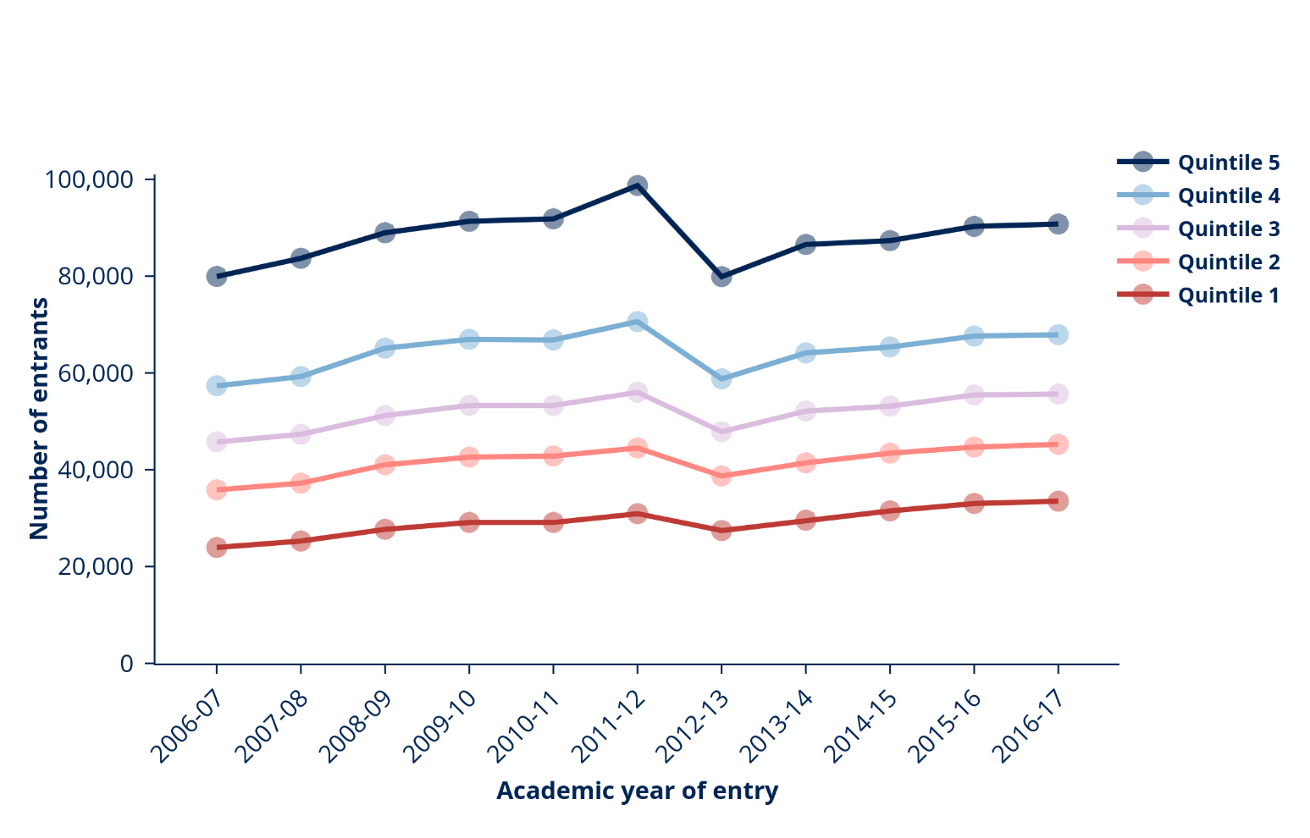
Entrants from low participation neighbourhoods (POLAR4) since 2006-07
Source: HESA, English institutions

Slide 12
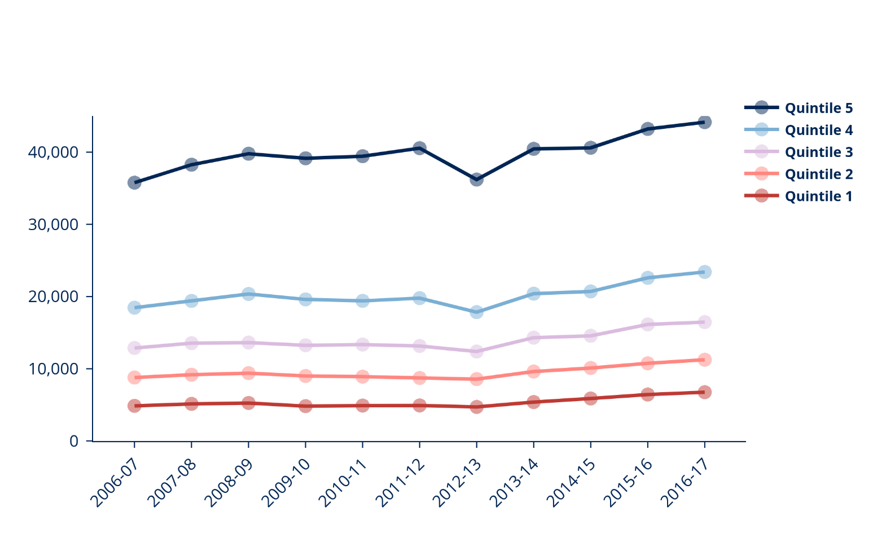
Entrants from low participation neighbourhoods (POLAR4) in high tariff universities since 2006-07
Source: HESA, English institutions

Slide 13
Other target groups
In addition, there are groups of students where there is specific evidence that barriers exist that may prevent equality of opportunity.
carers
people estranged from their families
people from Gypsy, Roma and Traveller communities
refugees
people with specific learning difficulties and mental health problems
children of military families

Slide 14
A new approach to regulating access and participation
We are aiming to:
achieve significant reductions in the gaps in access, success and progression over the next five years; and
ensure our access and participation regulation and funding are outcome-based, risk-based, underpinned by evidence and joined up with other OfS regulatory activities
Accept plans with a 5 year horizon, rather than annually
Focus on student outcomes, across the entire lifecycle
Notes:
Key points:
1. We are aiming to achieve significant reductions in the gaps in access, success and progression over the next five years
2. And ensure our access and participation regulation and funding are outcome-based, risk-based, underpinned by evidence and joined up with other OfS regulatory activities.
3. The review:
Focus on all stages of the lifecycle
Highlight our expectations for ambition
Highlight the importance of being outcomes focused
Highlight the role of evaluation/evidence
4. Ultimate aim of ensuring all students, from all backgrounds, with the ability and desire to undertake higher education, are supported to access, succeed in, and progress from higher education.

Slide 15
The OfS’s Key Performance Measures
We have set targets to eliminate:
The gap in entry rates at higher tariff providers between the most and least represented groups
The gap in non-continuation between the most and least represented groups
The gap in degree outcomes between white and black students
The gap in degree outcomes between disabled and non-disabled students
30.9 percentage points
4.4 percentage points
23.1 percentage points
2.8 percentage points

Slide 16
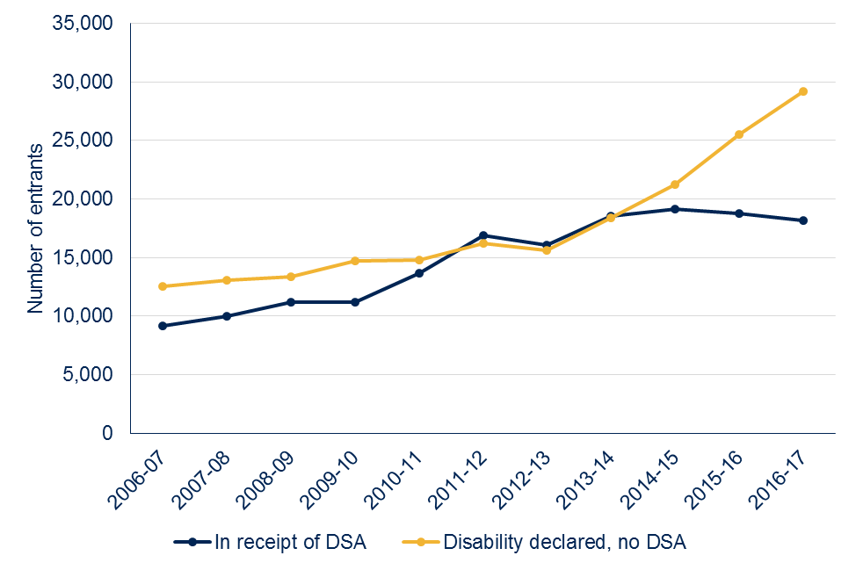
Access to HE - Disability
Number of full-time first degree UK entrants with a declared disability
Source: HESA (English publicly-funded providers)

Slide 17
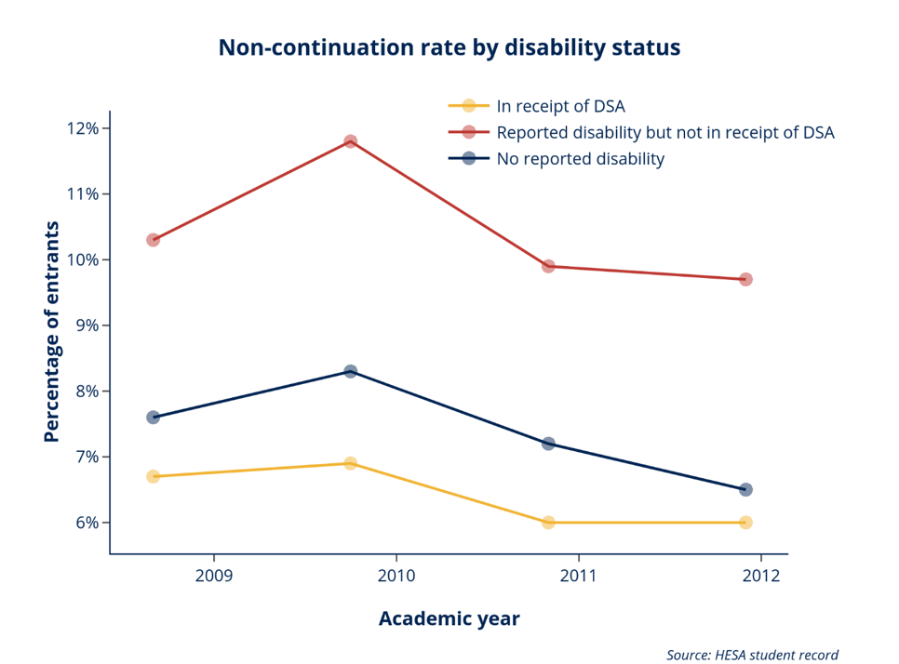
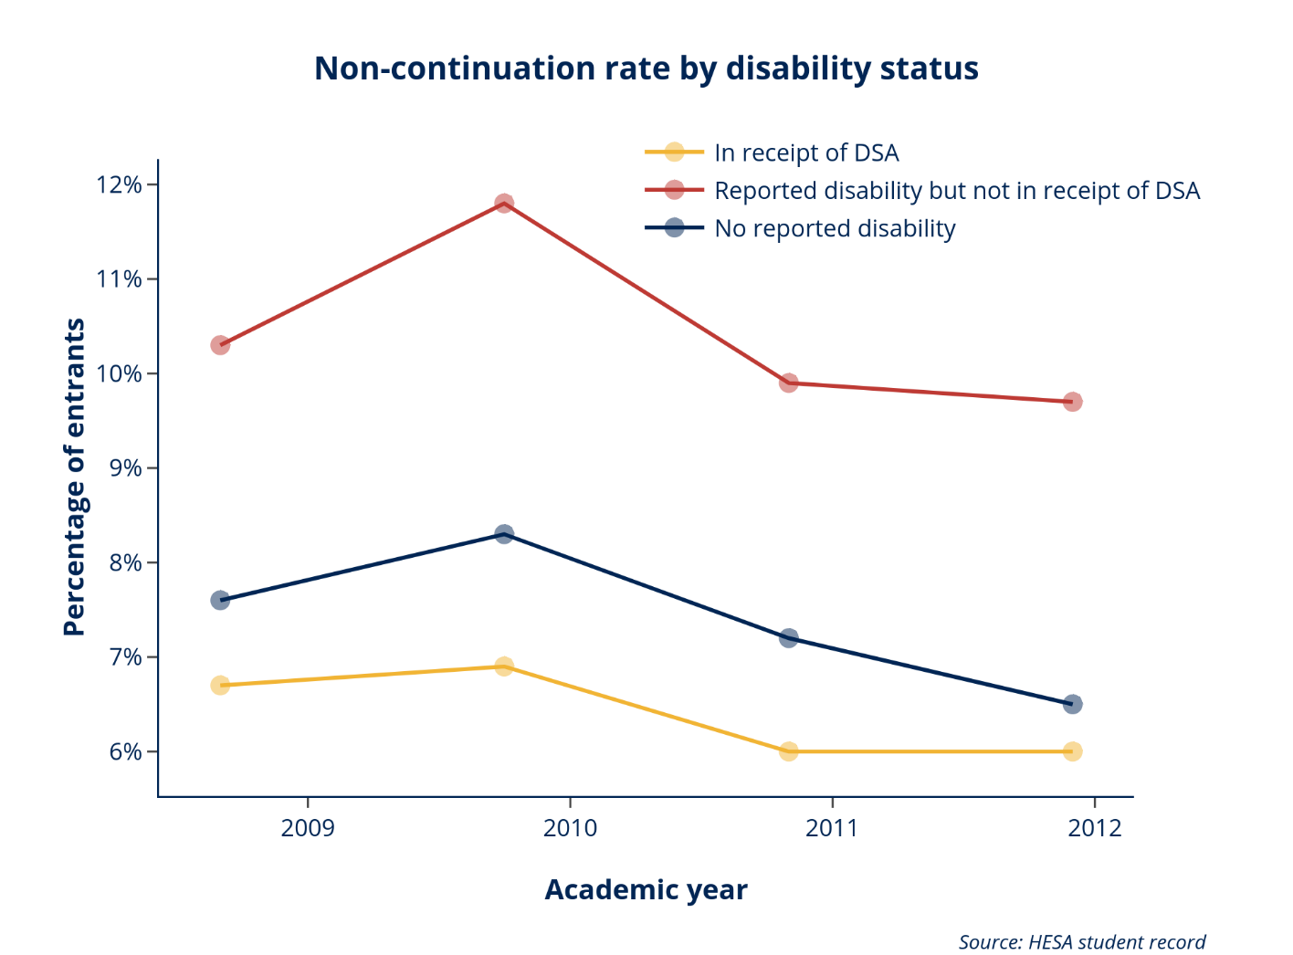
Non-continuation - Disability

Slide 18
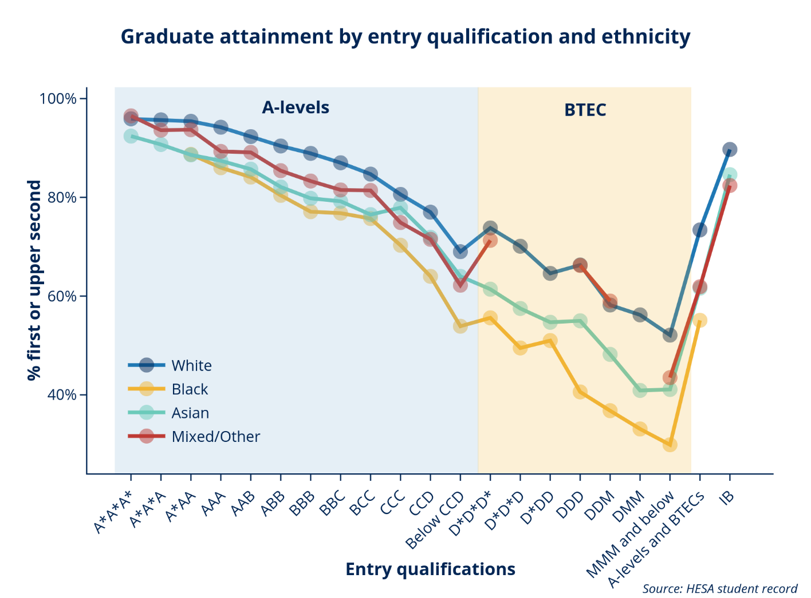
Attainment: Ethnicity
Success: degree outcomes – attainment gaps
The 22 percentage point gap in degree outcomes between the black and the white group is only reduced to 17 percentage points when other factors such as entry qualifications are considered.
https://www.officeforstudents.org.uk/data-and-analysis/differences-in-student-outcomes/

Slide 19
Gender identity of HE students
Study characteristic | Student characteristic | 2015-16 | 2016-17 | 2017-18
Full-time | Not the same as the gender assigned at birth | 6,235 | 1,925 | 1,840
 |  | 3.1% | 0.9% | 0.8%
 | Same as the gender assigned at birth | 186,350 | 207,405 | 225,625
 |  | 93.8% | 96.1% | 96.7%
 | Information refused | 6,180 | 6,455 | 5,875
 |  | 3.1% | 3.0% | 2.5%
 | Total | 198,765 | 215,790 | 233,340
Part-time | Not the same as the gender assigned at birth | 285 | 235 | 145
 |  | 0.9% | 0.8% | 0.5%
 | Same as the gender assigned at birth | 28,405 | 28,000 | 24,955
 |  | 94.2% | 95.2% | 93.6%
 | Information refused | 1,480 | 1,190 | 1,565
 |  | 4.9% | 4.0% | 5.9%
 | Total | 30,165 | 29,420 | 26,660

Slide 20
Sexual orientation of HE students

Slide 21
How does equality and diversity feature in access and participation plans?
Providers must include in their access and participation plan:
an explanation of the interaction between their access and participation plan and equality and diversity strategy
evidence they have considered the impact of activities and support measures on students with protected characteristics
evidence they have paid due regard to equality and diversity, as is their responsibility under the Equality Act 2010.
Notes:
Equality and diversity
There are strong links between access and participation, which is focused on groups underrepresented in higher education, and equality and diversity, which is focused on characteristics protected under the Equality Act 2010. You must, therefore, include within your access and participation plan:
an explanation of the interaction between your access and participation plan and your equality and diversity strategy
Recognising that people who share protected characteristics can be underrepresented in higher education
may be more likely to leave before finishing their course
less likely to achieve the highest qualification classifications
And less likely to be employed or in further study after graduation than those who do not.
There are clear benefits in, and many opportunities for, aligning your equality and diversity strategy and access and participation strategy.
Looking to understand how provider’s equality objectives relate to the strategic objectives set out in their APP.
evidence that you have considered the impact of your activities and support measures on students with protected characteristics, for example through an equality impact assessment
When evaluating current access and participation initiatives in relation to protected characteristics to highlight any differences in how your access and participation work impacts on different groups.
This should inform decisions on targeting
evidence that you have paid due regard to equality and diversity in designing your access and participation plan, as is your responsibility under the Equality Act 2010.
The Equality Act 2010 requires higher education providers to take equality issues into account when designing policies (including internal policies) and services, and to review such issues regularly.
We will not regulate whether you meet your legal obligations under the Equality Act 2010, but we expected you to demonstrate in your access and participation plan that you have executed these responsibilities.

Slide 22
What do we mean by ‘intersectional’?
Social
Diversity and power are connected
Power/society disadvantages some people and groups
Multiple sources of discrimination and oppression
Complex and cumulative
Evidence/Analysis
Multiple characteristics = multiple discrimination?
Which combination of characteristics amplify or reduce people’s outcomes?
Multiple equality indices
Multi factor analysis
Notes:
Diversity and power are connected. The structure of power and society places some groups of people at a disadvantage. We see this at work in higher education where certain groups of people do not access, continue, achieve or progress in the same way as others.
Often, if an individual has more than one characteristic which places them at a disadvantage, this makes it even harder for them to succeed. So we believe we need to understand these characteristics, but also how they ‘intersect’.
To do this, we analyse national data about the profile of higher education, so that we can identify and address inequalities across the sector. If the right data does not exist or is not good enough, we will work with the sector to improve it. We also combine quantitative and qualitative analysis, so that numerically smaller groups (such as, trans students) are not overlooked.
In practice this means we will be able to find those discrete groups experiencing more intractable barriers to access, continuation, attainment or progression in English higher education.

Slide 23
How does an intersectional analysis inform APPs?
Advised as a tool to target access and participation activities more effectively
Recognises that multiple factors will shape an individual’s identity, experience and outcomes
Students will experience multiple barriers
Single measures may miss certain groups who are most/least likely to enter HE
Important to look across the whole student lifecycle – not just entry
We highlight links between characteristic (e.g. LGBT or ‘first in family’) and other factors (e.g. mental health)
Small numbers might inhibit quantitative analysis – consider other means

Slide 24
Exploring intersectional data
UCAS Multiple Equality Measure (MEM)
Government’s Index of Multiple Deprivation
OfS Access & Participation Data Dashboard
Advance-HE Equality Statistical Reports
Any others?
What are you using?
Notes:
What data is already out there to help us understand the effects and outcomes of intersectional characteristics?

Slide 25
Government’s Index of Multiple Deprivation
The IMD ranks each small area in England from the 1st most deprived area, to the 32,844th least deprived area
Income
Employment
Education
Health
Crime
Barriers to housing & services
Living environment

Slide 26
UCAS Multiple Equality Measure (MEM)
UCAS’s principal measure of equality for students entering HE
Sex
Race
FSM
POLAR 3
School type

Slide 27
How does the MEM work?
Equality dimensions are combined using statistical modelling techniques
Linked to datasets of pupils in English schools aged 18 between 2006-2010
Probability of entry to HE aged 18 is then calculated on this combination of characteristics
Probabilities are used to group pupils into groups:
  Group 1 are least likely to enter HE (‘most disadvantaged’)
  Group 5 are most likely to enter HE (‘most advantaged’)
Entry rates can then be calculated and the trends assessed over time

Slide 28
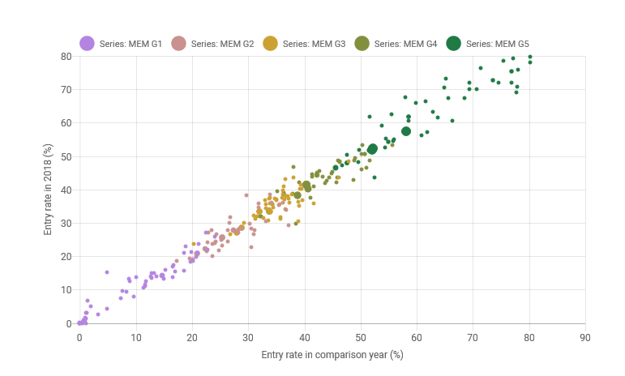
The MEM in practice

Slide 29
OfS Data
APP data dashboard
Sector level and provider level data
  Split across IMD, race, gender, disability, age, POLAR
  Small number of 2-way data splits (e.g. race plus POLAR)
Equalities/HESA individualised student data
Experimental data
OfS Intersectional Equality Measure:
  In development!
  Will focus on other areas of the student lifecycle beyond access (beyond the MEM)

