Slide 1
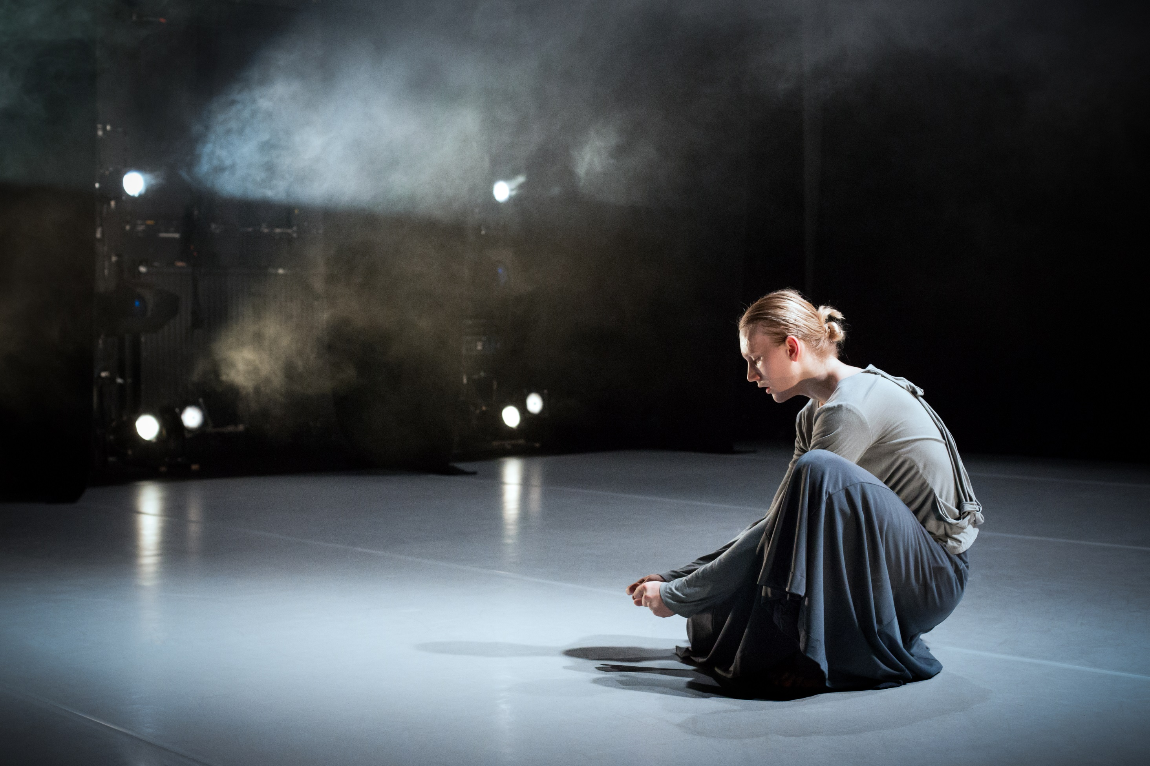
Intersectionalities in Higher Education
David Ruebain
Chief Executive Officer
Conservatoire for Dance and Drama

Slide 2
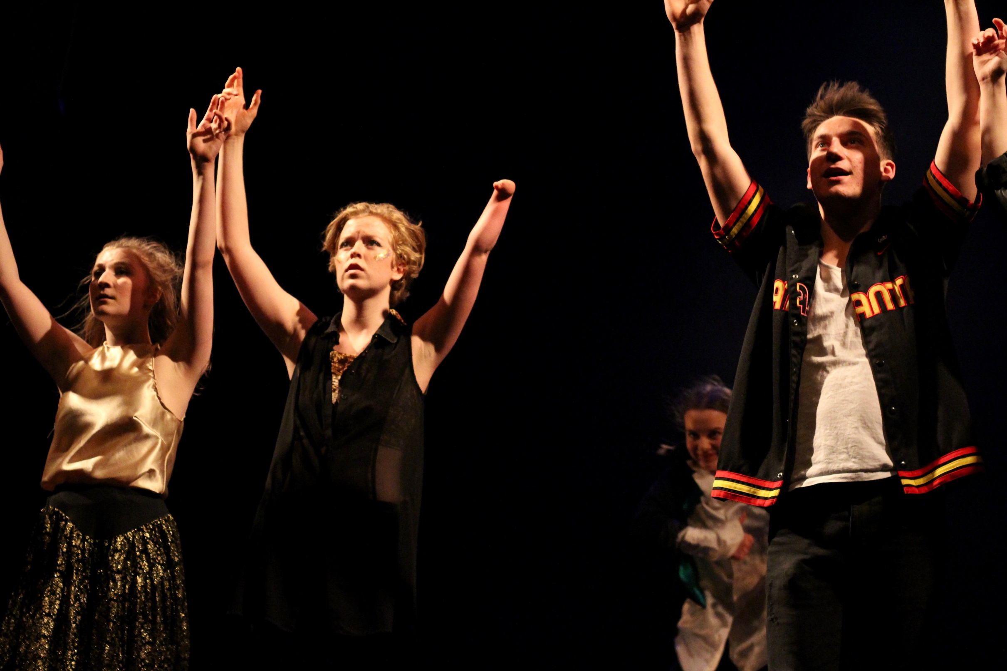
Where are the major areas of underrepresentation in higher education?

Slide 3
HE leadership demographics – disability
Managers, directors & senior officials in HE (non-academic and academic)
Known disability – 4.6%
No known disability – 95.4%
Gov UK national statistics: Declared disability = 21%
State pension age adults – 44%
Working-age adults – 18%
Children – 8 %
Sources – HESA Staff Statistics 2017/18; Gov UK Family Resources Survey 2017/18
Notes:
https://assets.publishing.service.gov.uk/government/uploads/system/uploads/attachment_data/file/791271/family-resources-survey-2017-18.pdf
https://www.hesa.ac.uk/news/24-01-2019/sb253-higher-education-staff-statistics

Slide 4
HE staff demographics – LGBTQ+
Equality data on LGBTQ+ representation in higher education is limited as fewer than 50% of staff return data on this characteristic.
Source: 2016/17 HESA staff return (all staff)
Staff returning data 2016-17
Bisexual | 2,465 | 0.6%
Gay man | 3,905 | 0.9%
Gay woman/lesbian | 2,160 | 0.5%
Heterosexual | 156,115 | 37.2%
Other | 1,535 | 0.4%
Information refused | 41,515 | 9.9%
Blank | 212,015 | 50.5%
Total | 419,710

Slide 5
HE Staff demographics – disability and LGBTQ+
The same limitations of data apply when considering the intersectionality of disabled and LGBTQ+ staff. Of respondents, the number identifying as disabled and LGBTQ+ is very small – 0.3%.
 | Non-disabled |  | Disabled |  | All staff
LGBTQ+* | 8,800 | 2.1% | 1,260 | 0.3% | 10,065
Heterosexual | 147,120 | 35% | 8,995 | 2.1% | 156,115
Information refused | 39,570 | 9.4% | 1,945 | 0.5% | 41,515
Blank | 204,420 | 48.7% | 7,595 | 5.1% | 212,015
All staff | 399,910 |  | 19,800 |  | 419,710
*Responded as Bisexual, Gay man, Gay woman/lesbian, Other

Slide 6
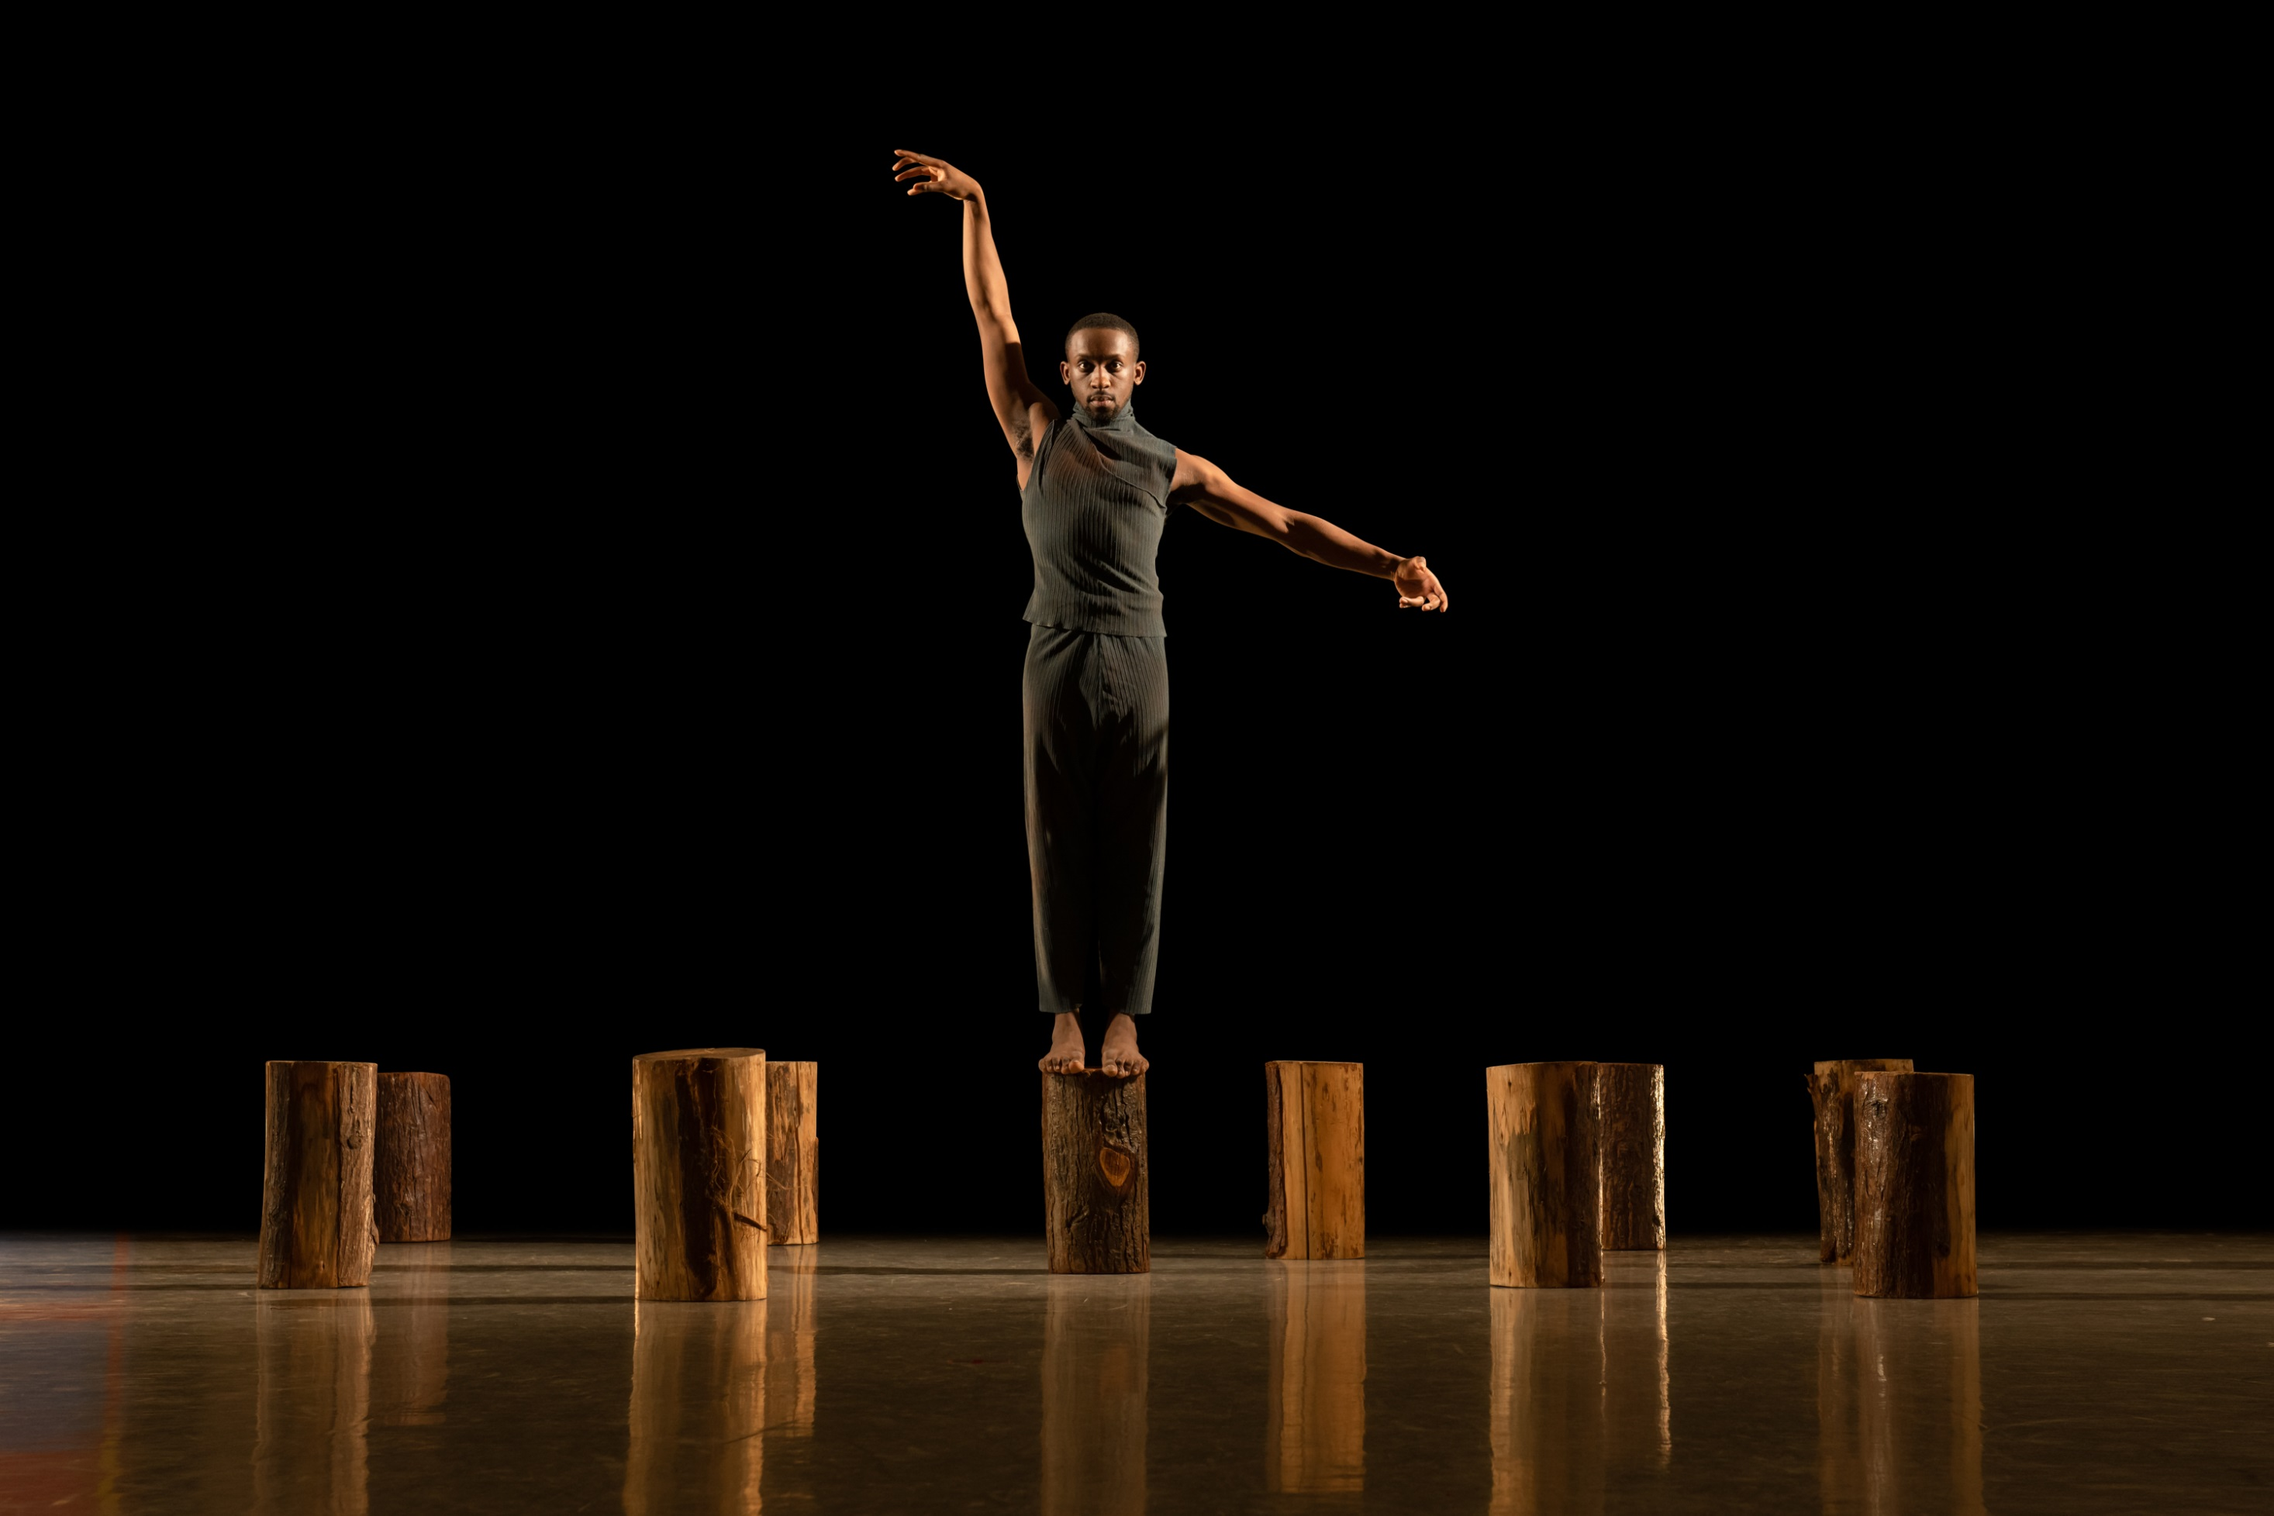
Leadership
What is a ‘correct’ model of leadership?
How can the concept of ‘authentic leadership’ help to improve representation?

Slide 7
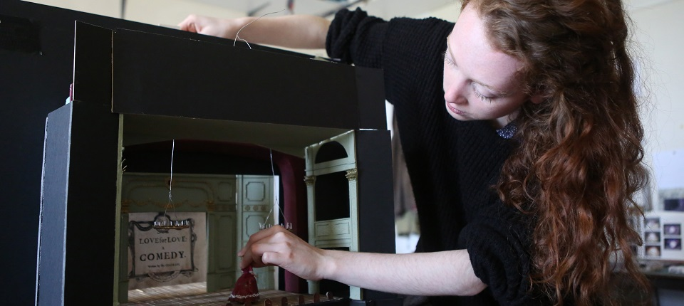
Discourse of identity
Constructed vs essential
Identity as a juxtaposition against ‘norms’
Who can speak for an identity or community?

Slide 8
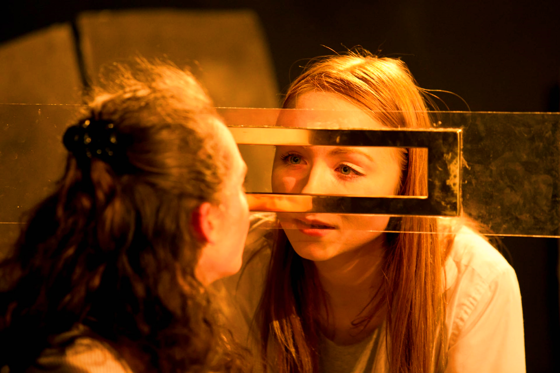
“I am not who you think I am. I am not who I think I am. I am who I think you think I am.”
- Charles Cooley

Slide 9
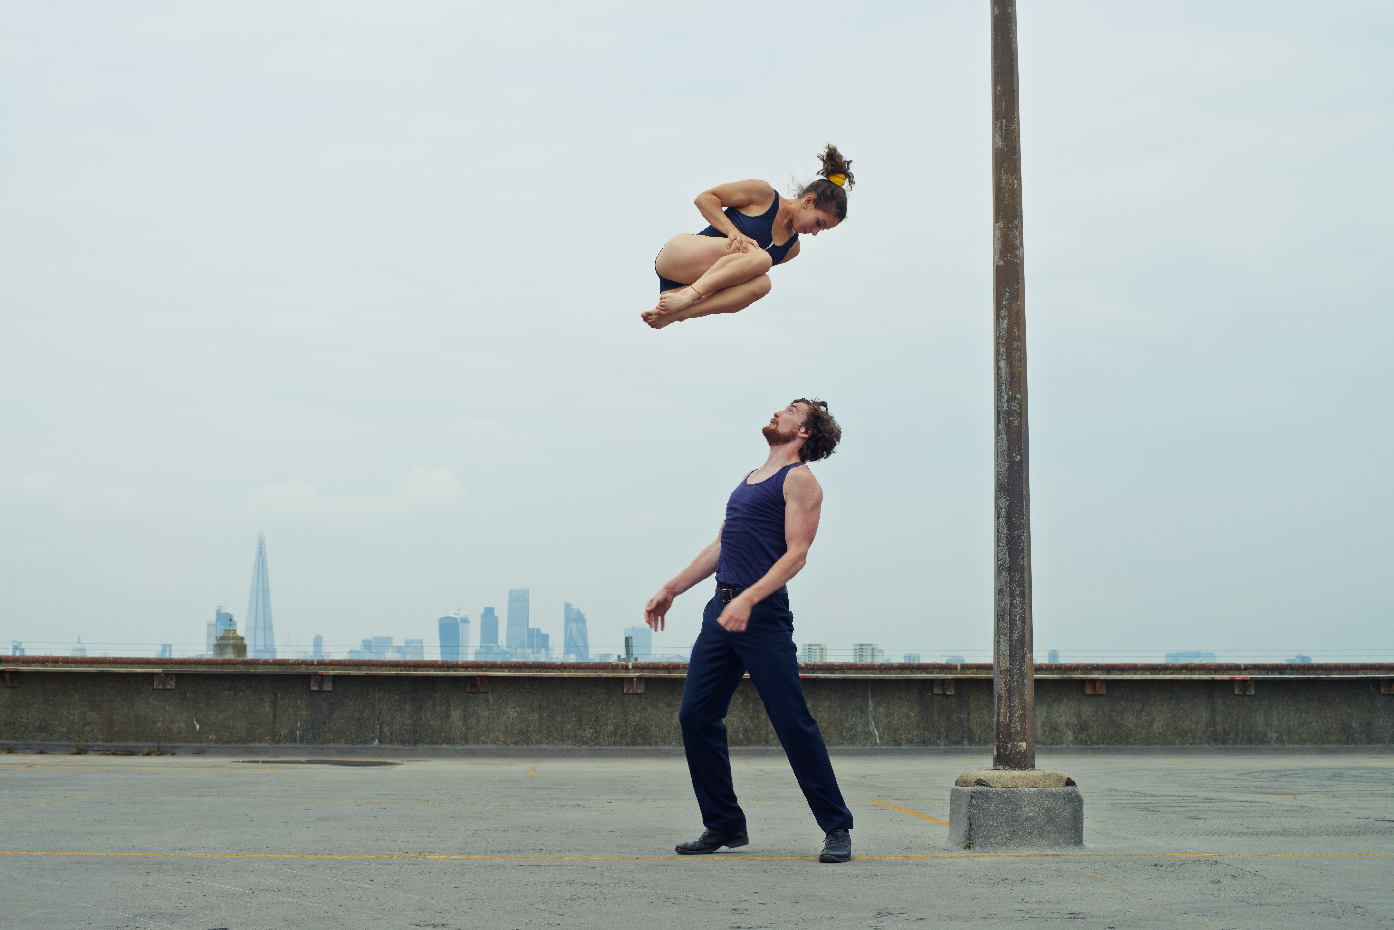
Communication
What discourse can we use to improve discussion?
Non-violent communication as a tool

Slide 10
Questions, comments, thoughts?

